Slide 1
Information Systems in Construction Sector
CSE329 – MANAGEMENT INFORMATION SYSTEMS
D1 Slot
Prof. Christy Jackson. J

Slide 2
Team Members:
D. Shashank – 13BCE1036
K. Gourav – 13BCE1068
S. Chanakya Yadav – 13BCE1162

Slide 3
Information System
Information system can be interpreted as a tool which enhances the organization through different technical and smart methodologies so as to reduce human effort, time and irrelevant investment wastage.
It is not only the information technology that are being used in the organization. Information system is somewhat different from that. Information system gives reports, enhances ways of generating reports, gives an interface between the organization and its performance.

Slide 4
Construction Systems
What happens in a construction system:
Accept a contract
Estimate the budget
Design a plan
Sales and Marketing
Construct

Slide 5
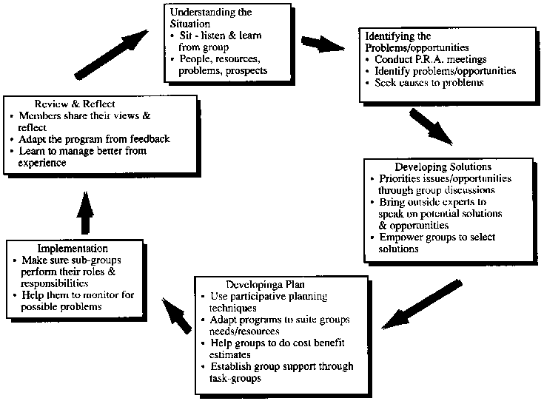

Slide 6
Accept a Contract
Contracts are not obtained as such when the company enters the field.
The company has to publicize itself and place tenders for several government take – ups (if interested). In order to gain experience and trust, few normal government projects have to be done because people hesitate giving contracts to new ones.
If suppose, a private contract has arrived, conditions like land value in the area, permission restrictions, approximate population in the region etc. factors have to be considered and checked before taking the land and starting construction.

Slide 7
Design a Plan
A plan has to be designed for construction of buildings, apartments etc. Pan doesn’t mean that a step of procedures should be maintained. It is the front view and side view of the construction. For some constructions, we may need the top view also.
Using the plan, we need to calculate the raw materials needed. For example, to construct a wall of 10x15 feet with a brick size of 1x0.3 feet, we need 500 bricks. This is for one side and just for bricks. Estimation and calculation must be done for the whole building and a perfect list of materials need to be prepared.
No company use their raw materials efficiently, so for each raw materials, a bench mark of 2% of it is added.

Slide 8
Estimate the Budget
This is the next most crucial part in construction industry. The survival of the contract, company etc. depends on the estimation of budget.
The workers’ salary, engineers, managers – their salaries, government clearances, material costs, model flats constructions, furniture's cost, office branch construction.
Company sim cards should be issued to the executives part of the job.
For sustainable reasons, a grace budget of 3 to 4% is estimated more.

Slide 9
Construct
Man power and now of days have to be estimated and a daily procedure has to be followed.
Timelines and check points have to be maintained.
Cranes, Construction vehicles, bore installer machines, rock breaking machines etc. have to be taken for rent as per the requirement.
Construction should happen smoothly.
Safety should be taken care of.
Children should not be allowed in the construction part which violates the ethical principle of child labor.

Slide 10
Sales and Marketing
This is the most challenging phase of construction business.
Stalls have to be installed in exhibitions, ads should be given, model flat should be made, brochures should be made and sales have to be promoted.
Websites, social media etc. are also adopted in some construction companies.
Opening sales should be given with some discount such that the profit function does not get effected much.
Usually, profit is calculated per square feet. So, the current value of land during the time of sales should also be taken into consideration.

Slide 11
Timeline
Review 2:
What changes can information system bring in the above aspects??
How does they reduce the time and energy factor??
How does it show impact on the surroundings and on the business??
Is the profit obtained due to usage of information systems worth the investment??
To what extent, information systems are used currently?? Why stop there??
What are the types of information systems that can be used??
Final Review:
Final report of the project.

Slide 12
Thank you

